Slide 1
State of Wisconsin School Report Cards Fall 2014 Results

Slide 2
Tonight’s Report
A brief overview of the new State School Report Cards
An update on our 2014 results

Slide 3
Department of Public Instruction “Agenda 2017”
ESEA Waiver
Avoid AYP penalties
Standards
Common Core State Standards
Assessment and Data Systems
Smarter Balanced Assessments
School & Educator Effectiveness
School Report Cards
Response to Intervention
Educator Effectiveness System
WI Waiver Request
State SIS
TONIGHT’s FOCUS

Slide 4
Higher Expectations
Cut scores for all proficiency categories are much more rigorous to reflect the new expectations within the Common Core State Standards
Distance between cut scores more narrow than previous WKCE expectation
Examples:
A 7th grader who received a reading score of 470 in 2011 would have been Proficient in reading – now considered Minimal
A 4th grader with a reading score of 490 in 2011 would have been considered Advanced – now is Basic

Slide 5
School Report Card
The data presented in this report card are for public, state and federal accountability purposes.
Student performance on the Wisconsin Student Assessment System (WSAS) is the foundation of this report.
WSAS data includes both Wisconsin Knowledge and Concepts Examinations (WKCE) and Wisconsin Alternate Assessment for Students with Disabilities (WAA-SwD).
Results are from the previous year’s test administration.
Each school receives a report card in addition to an overall district report card.

Slide 6
Components:
1. Accountability Determination
2. Priority Areas
3. Student Engagement Indicators
4. School Information
5. WSAS Percent Proficient and Advanced

Slide 7
Components:
1. Accountability Determination
2. Priority Areas
3. Student Engagement Indicators
4. School Information
5. WSAS Percent Proficient and Advanced
Notes:
First is the accountability determination – giving an overall school score on a scale of 1-100, broken down into five categories. This accountability rating on and the other accountability scores here are based on Full Academic Year students (FAYs). This is not a “percent score” rather a caculated score out of 100 points possible built from scores in 4 category areas.

Slide 8
Components:
1. Accountability Determination
2. Priority Areas
3. Student Engagement Indicators
4. School Information
5. WSAS Percent Proficient and Advanced
Accountability Rating Category | Level of Support from the DPI
Significantly Exceeds Expectations | Rewards and Replication
Exceeds Expectations | Rewards and Replication
Meets Expectations | Local Improvement Efforts
Meets Few Expectations | State Support
Fails to Meet Expectations | State Support
Notes:
Second, the 4 priority areas build together to determine the accountability rating. The major change on this report card will be in this state score column. Instead of the K-12 average state score, it will be a state average for schools in one of five bins—K-5, K-8, 6-8, 9-12, or K-12. That will give a better comparison for your schools.
We’ll go through these and their calculations in more depth next.

Slide 9
Components:
1. Accountability Determination
2. Priority Areas
3. Student Engagement Indicators
4. School Information
5. WSAS Percent Proficient and Advanced
Notes:
Second, the 4 priority areas build together to determine the accountability rating. The major change on this report card will be in this state score column. Instead of the K-12 average state score, it will be a state average for schools in one of five bins—K-5, K-8, 6-8, 9-12, or K-12. That will give a better comparison for your schools.
We’ll go through these and their calculations in more depth next.

Slide 10
Components:
1. Accountability Determination
2. Priority Areas
3. Student Engagement Indicators
4. School Information
5. WSAS Percent Proficient and Advanced
Student Achievement for Reading and Math – How many students are proficient or above on the WKCE?
Student Growth- How many students showed growth or decline by moving proficiency categories?
Closing Gaps – How are your smaller demographic groups doing on the test compared to their peers? If there is a gap, is it getting smaller? This includes graduation rate at the HS level.
On-Track and Post-Secondary Readiness – Are our students “on track” for meeting career and college readiness benchmarks? Measures for this include grade 3 reading, grade 8 math, attendance, graduation rate and ACT participation.
Notes:
Second, the 4 priority areas build together to determine the accountability rating. The major change on this report card will be in this state score column. Instead of the K-12 average state score, it will be a state average for schools in one of five bins—K-5, K-8, 6-8, 9-12, or K-12. That will give a better comparison for your schools.
We’ll go through these and their calculations in more depth next.

Slide 11
Components:
1. Accountability Determination
2. Priority Areas
3. Student Engagement Indicators
4. School Information
5. WSAS Percent Proficient and Advanced
Notes:
Third, if criteria are not met, the student engagement indicators can lead to deductions from the schools accountability score. These are the old red flags, and later as we discuss how to calculate your accountability score, we’ll talk more about how these affect calculations.

Slide 12
Components:
1. Accountability Determination
2. Priority Areas
3. Student Engagement Indicators
4. School Information
5. WSAS Percent Proficient and Advanced
DEDUCTIONS
Test Participation
Must be greater than 95%
Absenteeism Rate
Must be less than 13%
Dropout Rate
Must be less than 6%
Notes:
Second, the 4 priority areas build together to determine the accountability rating. The major change on this report card will be in this state score column. Instead of the K-12 average state score, it will be a state average for schools in one of five bins—K-5, K-8, 6-8, 9-12, or K-12. That will give a better comparison for your schools.
We’ll go through these and their calculations in more depth next.

Slide 13
Components:
1. Accountability Determination
2. Priority Areas
3. Student Engagement Indicators
4. School Information
5. WSAS Percent Proficient and Advanced
Notes:
Fourth, there’s a box providing school demographic information. This helps to see which subgroups are involved in the calculations and the size of those subgroups.

Slide 14
Components:
1. Accountability Determination
2. Priority Areas
3. Student Engagement Indicators
4. School Information
5. WSAS Percent Proficient and Advanced
Demographics
School Type (Elem, MS or HS)
Enrollment
Race / Ethnicity Groups
Other Student Groups including:
Students with Disabilities
Economically Disadvantaged
Limited English Proficient
Notes:
Second, the 4 priority areas build together to determine the accountability rating. The major change on this report card will be in this state score column. Instead of the K-12 average state score, it will be a state average for schools in one of five bins—K-5, K-8, 6-8, 9-12, or K-12. That will give a better comparison for your schools.
We’ll go through these and their calculations in more depth next.

Slide 15
Components:
1. Accountability Determination
2. Priority Areas
3. Student Engagement Indicators
4. School Information
5. WSAS Percent Proficient and Advanced
Notes:
Fifth, there is a box containing overall trend data for the school for the past five years, showing the % of students at the school and at the state who are proficient in math and reading – uses the new NAEP cut scores.
WSAS – Wisconsin Student Assessment System. This will allow you to see trend data. WINSS will not have this trend data within it – in current WINSS system you won’t be able to see past data aligned with the new cut-scores (at least not at this point).
Pause here and note the importance of celebrating your successes! This is not easy. You may see data that shows your increasing or even staying steady, which might be a success in itself. Find things to celebrate at your school—might not be test scores (arguably they tell only a very limited story of what’s going on at a school).

Slide 16
Components:
1. Accountability Determination
2. Priority Areas
3. Student Engagement Indicators
4. School Information
5. WSAS Percent Proficient and Advanced
5 Year Look at the
School’s Data
Percent Proficient & Advanced for Math (overall)
Percent Proficient & Advanced for Reading (overall)
Comparison to State Average
Notes:
Second, the 4 priority areas build together to determine the accountability rating. The major change on this report card will be in this state score column. Instead of the K-12 average state score, it will be a state average for schools in one of five bins—K-5, K-8, 6-8, 9-12, or K-12. That will give a better comparison for your schools.
We’ll go through these and their calculations in more depth next.

Slide 17
CALCULATIONS
Every area has a set of calculations and data points that it uses to assign a value in relation to the total points available for that section.
Some parts we can calculate using the information DPI gives us and some parts are a “black box” calculation.

Slide 18
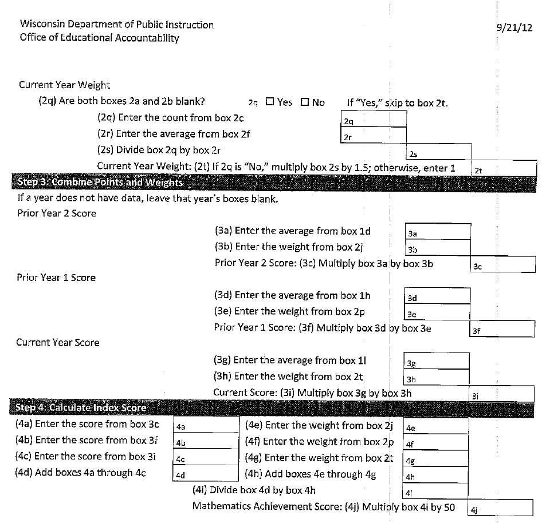
Calculations are complex and complicated

Slide 19
Student Growth Percentile (SGP)
Notes:
SGP – these student growth percentiles were made available to schools last year, showing how individual students are progressing. The new school report does not itself use value-added calculations, but it uses these individual level growth calculations (there has been some debate about this). These student level growth calculations can also be used in a value-added analysis to see how growth varies among groups of students based on the school they’re at, the teacher they have, the program they’re in, etc.

Slide 20
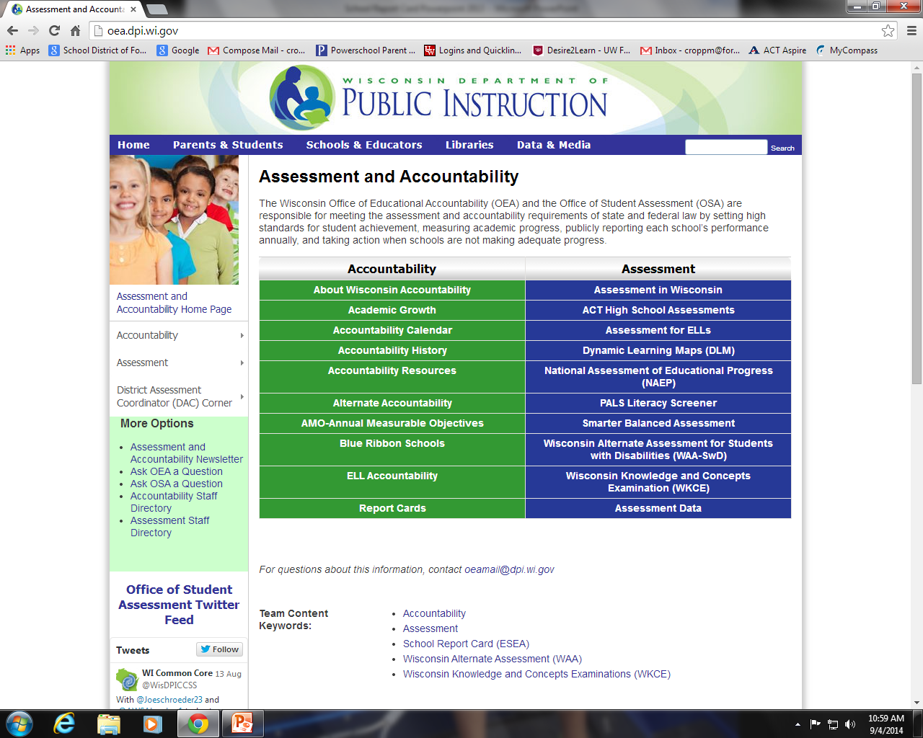
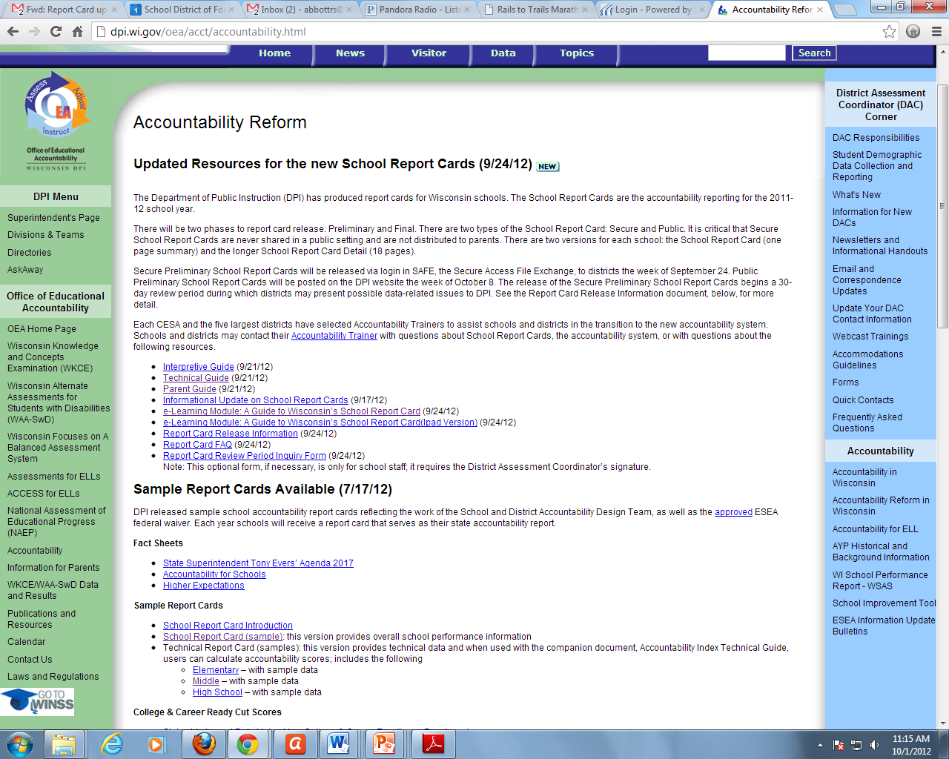
http://dpi.wi.gov/oea/acct/accountability.html
http://oea.dpi.wi.gov/

Slide 21
Fort Atkinson Report Card Results 2014
 | Accountability Score | Accountability Rating
Barrie | 81.0 | Exceeds Expectations
Luther | 75.3 | Exceeds Expectations
Purdy | 77.7 | Exceeds Expectations
Rockwell | 78.2 | Exceeds Expectations
Middle School | 69.0 | Meets Expectations
High School | 77.4 | Exceeds Expectations

Slide 22
Fort Atkinson Report Card Results
Building | Accountability Score |  |  | Accountability Rating
 | 2012 | 2013 | 2014 | 2012 | 2013 | 2014
Barrie | 71.1 | 87.0 | 81.0 | Meets | Signif. Exceeds | Exceeds
Luther | 75.0 | 71.4 | 75.3 | Exceeds | Meets | Exceeds
Purdy | 68.7 | 75.9 | 77.7 | Meets | Exceeds | Exceeds
Rockwell | 75.7 | 73.5 | 78.2 | Exceeds | Exceeds | Exceeds
Middle School | 69.7 | 71.5 | 69.0 | Meets | Meets | Meets
High School | 74.3 | 73.9 | 77.4 | Exceeds | Exceeds | Exceeds

Slide 23
Fort Atkinson Report Card Results district
Year | Accountability Score | Accountability Rating
2014 | 72.5 | Meets Expectations
2013 | 72.5 | Meets Expectations

Slide 24
Priority Area Scores STUDENT ACHIEVEMENT MATH
 | Math (out of 50)
 | 2012 |  | 2013 |  | 2014
 | Local | State | Local | State | Local | State
BARRIE | 40.8 | 37.9 | 43.4 | 37.8 | 45.1 | 38.1
LUTHER | 37.1 | 37.9 | 37.5 | 37.8 | 39.8 | 38.1
PURDY | 39.2 | 37.9 | 39.0 | 37.8 | 39.8 | 38.1
ROCKWELL | 46.0 | 37.9 | 43.4 | 37.8 | 44.0 | 38.1
MIDDLE SCHOOL | 37.1 | 36.1 | 38.0 | 36.7 | 36.9 | 36.8
HIGH SCHOOL | 34.6 | 34.5 | 36.3 | 35.3 | 37.6 | 35.8

Slide 25
Priority Area Scores STUDENT ACHIEVEMENT READING
 | Reading (out of 50)
 | 2012 |  | 2013 |  | 2014
 | Local | State | Local | State | Local | State
BARRIE | 29.5 | 28.5 | 33.0 | 28.7 | 33.7 | 28.8
LUTHER | 27.6 | 28.5 | 28.4 | 28.7 | 27.7 | 28.8
PURDY | 27.4 | 28.5 | 27.4 | 28.7 | 30.0 | 28.8
ROCKWELL | 35.4 | 28.5 | 33.3 | 28.7 | 34.4 | 28.8
MIDDLE SCHOOL | 30.8 | 30.3 | 31.4 | 30.7 | 31.3 | 30.5
HIGH SCHOOL | 31.9 | 32.0 | 32.3 | 32.2 | 35.4 | 33.3

Slide 26
Priority Area Scores STUDENT GROWTH MATH
 | Math (out of 50)
 | 2012 |  | 2013 |  | 2014
 | Local | State | Local | State | Local | State
BARRIE | 33.1 | 33.2 | 44.1 | 32.3 | 37.1 | 33.6
LUTHER | 36.8 | 33.2 | 28.9 | 32.3 | 32.7 | 33.6
PURDY | 28.7 | 33.2 | 35.1 | 32.3 | 29.7 | 33.6
ROCKWELL | 35.2 | 33.2 | 33.7 | 32.3 | 40.6 | 33.6
MIDDLE SCHOOL | 29.5 | 28.1 | 30.1 | 28.7 | 25.2 | 27.7
HIGH SCHOOL | N/A | N/A | N/A | N/A | N/A | N/A

Slide 27
Priority Area Scores STUDENT GROWTH READING
 | Reading (out of 50)
 | 2012 |  | 2013 |  | 2014
 | Local | State | Local | State | Local | State
BARRIE | 29.4 | 34.2 | 44.1 | 33.4 | 32.6 | 34.2
LUTHER | 36.4 | 34.2 | 28.9 | 33.4 | 36.8 | 34.2
PURDY | 34.1 | 34.2 | 38.4 | 33.4 | 36.7 | 34.2
ROCKWELL | 38.4 | 34.2 | 39.5 | 33.4 | 39.8 | 34.2
MIDDLE SCHOOL | 28.9 | 26.9 | 27.3 | 25.0 | 30.3 | 28.0
HIGH SCHOOL | N/A | N/A | N/A | N/A | N/A | N/A

Slide 28
Priority Area Scores CLOSING GAPS 2014
 | Math (out of 50 @ K-8) (out of 25 @ HS) |  | Reading (out of 50 @ K-8) (out of 25 @HS) |  | Graduation Rate Gaps (out of 50 – HS only)
 | LOCAL | STATE | LOCAL | STATE | LOCAL | STATE
BARRIE | 42.2 | 32.9 | 42.2 | 34.0 | N/A | N/A
LUTHER | 42.0 | 32.9 | 35.6 | 34.0 | N/A | N/A
PURDY | 40.4 | 32.9 | 45.5 | 34.0 | N/A | N/A
ROCKWELL | 29.4 | 32.9 | 35.0 | 34.0 | N/A | N/A
MIDDLE SCHOOL | 30.5 | 32.5 | 31.8 | 34.0 | N/A | N/A
HIGH SCHOOL | 21.7 | 17.0 | 23.6 | 17.5 | 30.0 | 32.9

Slide 29
Priority Area Scores On-Track & Post-Secondary Readiness 2014
 | Attendance Rate (out of 80) |  | 3rd Grade Reading Achievement (out of 20)
 | LOCAL | STATE | LOCAL | STATE
BARRIE | 77.1 | 75.5 | 13.9 | 11.5
LUTHER | 75.9 | 75.5 | 10.8 | 11.5
PURDY | 76.4 | 75.5 | 12.2 | 11.5
ROCKWELL | 76.0 | 75.5 | 13.8 | 11.5

Slide 30
Priority Area Scores On-Track & Post-Secondary Readiness 2014
 | Attendance Rate (out of 80) |  | 8th Grade Reading Achievement (out of 20)
 | LOCAL | STATE | LOCAL | STATE
MIDDLE SCHOOL | 75.0 | 74.9 | 15.0 | 14.4
 | Graduation Rate (out of 80) |  | ACT Participation & Performance (out of 20)
 | LOCAL | STATE | LOCAL | STATE
HIGH SCHOOL | 75.8 | 71.9 | 11.4 | 11.6

Slide 31
Detailed School Report Cards for Each School Available on our Website: www.fortschools.org

Slide 32
Next Steps & Implications …
Continue our planned work with the current strategic plan goals as they directly relate to these measures
Closer focus than ever on achievement gaps and growth
Continued transition to the Common Core Standards and increase rigor
Increased pressure for data accuracy
Assure best proctoring for this WKCE session
Data analysis, in combination with our local data, with a goal of continuous organizational improvement

